Slide 1


Telomeric pattern searching in DNA sequences
Priyatham Beesipogu - 01204427
HPC – Spring 2022
Under the guidance of Dr. mohammad Zubair
Special Thanks to ELENI ADAM

Slide 2
Agenda
Overview
Basic Approach
Basic CUDA implementation
Basic OneAPI implementation
Optimized approach
Results
Comparing CUDA & oneAPI environments
Challenges faced
Future Work
Live Demo

Slide 3
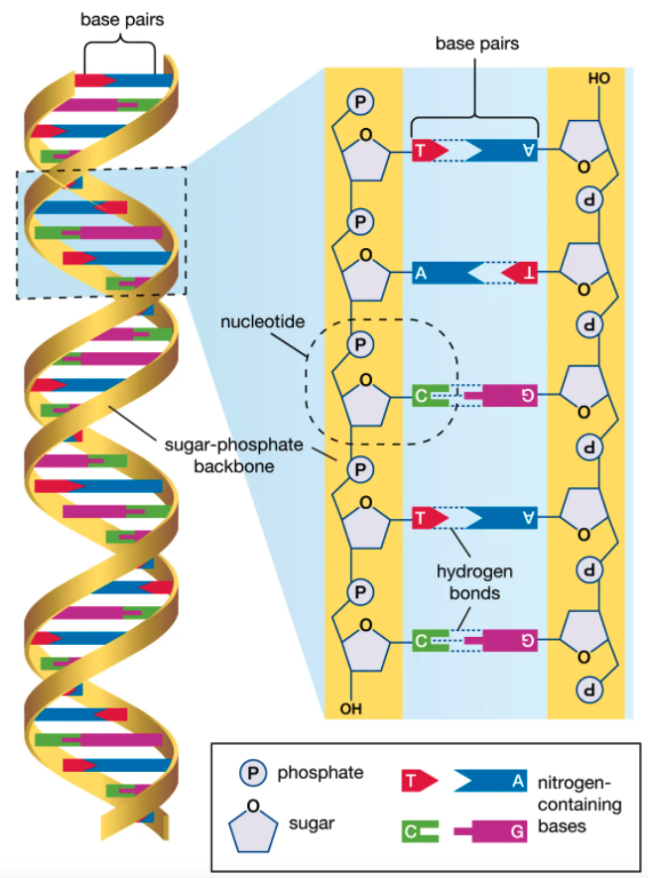
Overview
Telomeric Pattern: TTAGGGTTAGGGTTAGGGTTAGGG
Problem Statement: To identify the DNA sequences which contains the telomeric pattern
Motivation behind choosing this project:
Straight forward problem
Apt domain
KMP pattern searching algorithm has been modified and used:
The read must contain the "TTAGGGTTAGGGTTAGGGTTAGGG" pattern at least twice.
The last occurrence of the pattern must be located near the read's end (less than 20,000 bases from the end of the read).

Slide 4
Overview
Datasets provided:
subset_na12878dataset_15GB.fasta
na12878dataset_25GB.fasta
chm13_dataset_375GB.fasta
The datasets has DNA pieces in fasta format.
Each DNA piece has a read_ID(ID of that sequence) followed by actual DNA sequence
Example:
>Read_ID1
CAATTCCGATAGGCCTATATAGGAAAACCCTAAGGTAAGGGGCT

Slide 5
Basic approach
Fetch input DNA sequences
Processing in Kernel
Matched sequences to output

Slide 6
Basic cuda approach
Fetch input data
cudaMalloc()
cudaMemcpy(…., cudaMemcpyHostToDevice)
Kernel<<<1,1>>>() - Pattern searching using KMP
cudaMemcpy(…., cudaMemcpyDeviceToHost)
cudaFree()
Write matched sequences to output file

Slide 7
Basic oneapi approach
Fetch input data
malloc_device<datatype>()
q.memcpy(dest, src, size).wait()
q.parallel_for(range<1>(N), [=](id<1> index) {…} – Pattern searching using KMP
q.memcpy(dest, src, size).wait()
free()
Write matched sequences to output file

Slide 8
OPTIMIZED approach
Copy to device memory
Processing (Pattern Matching)
Write to output
Fetch N DNA pieces
Allocate size for N DNA pieces
Deallocate size of N DNA pieces

Slide 9
Optimized approach
Can’t allocate memory for all input data at once, hence processing chunk of data at a time (N pieces)
Launching each pattern finding task of a sequence on a different thread (N threads)
Reusing the same constant allocated memory for all input data
Pinned Memory implementation in CUDA – cudaMallocHost()
Explicit Unified Shared Memory(USM) Allocation in OneAPI – malloc_device<datatype>()

Slide 10

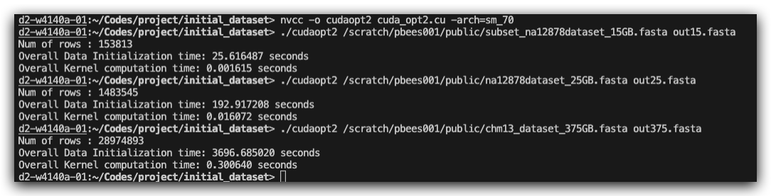
Results
CUDA code is 8x faster than CPU code on 15GB data

Slide 11
Comparing cuda & oneapi
OneAPI has easily implementable kernel
CUDA programming feels like everything’s written from scratch, more visible what’s going on, where are we stuck at. How a thread is being used can be found
More debug tools available in Cuda, debugging is a nightmare in OneAPI
OneAPI - hard to setup in terminal
Output isn’t readily available for tasks taking more than 60 secs and no notification – oneapi
Cuda trainings were great but didn’t cover everything like pipeline
Overall I prefer CUDA

Slide 12
Challenges faced
While sending a large 2D char array to kernel
15GB data uploading to devcloud server – split and uploaded
Deciding on which approach would be better for OneAPI (buffers, accessors, shared memory, etc..)
Setting up devcloud connection in terminal
Server issues
Devcloud output varies if file opened before write complete
Segmentation fault, Threads synchronization

Slide 13
FUTURE work
If somehow able to allocate more global memory than 2 GB
Multi GPU approach
Pipelining approach
Remove dependency on max pattern length

Slide 14
References
http://rosettacode.org/wiki/FASTA_format#C.2B.2B
https://developer.nvidia.com/blog/how-optimize-data-transfers-cuda-cc/
https://www.olcf.ornl.gov/cuda-training-series/
https://devcloud.intel.com/oneapi/get_started/
https://www.intel.com/content/www/us/en/developer/tools/oneapi/training/overview.html
https://github.com/olcf/cuda-training-series/tree/master/exercises/
https://devcloud.intel.com/oneapi/documentation/connect-with-ssh-linux-macos/
https://kb.iu.edu/d/afar
https://www.networkworld.com/article/3489256/breaking-linux-files-into-pieces-with-the-split-command.html
And a lot more stackoverflow links..

Slide 15

THANK YOU

Slide 16


